Slide 1

CS 546 – Web Programming I
API Development and Intermediate MongoDB

Slide 2
Intermediate MongoDB

Slide 3
Demonstration
In Lecture 6’s repository, see advanced_mongo.js for examples. In this file, a module is exported detailing many of the functions listed.
I would recommend running node in the command line, requiring advanced_mongo.js, and experimenting with it accordingly. Or, you can write your own driver to experiment.
Note: the data for this collection will rebuild itself every time you require the file, and for simplicity’s sake the id’s are being stored as integers. At the end of every function, the changes will be logged. Feel free to change this!

Slide 4
Advanced Querying
We can find documents many more ways than just matching on multiple fields:
Query by subdocuments.
Query for matches inside an array.
Query for a field to be one of many values.
Matching fields that are less than (or equal to) a value.
Matching fields that are greater than (or equal to) a value.
Performing a logical query for all matching queries, or any matching queries.
JavaScript based querying!
We can also do things like:
Limiting and Skipping documents
Returning only certain fields
Sorting

Slide 5
Advanced Updating
There are many ways we can update documents, rather than just replacing their entire content.
We can change only specific fields
Update subdocuments
Increment fields
Multiply fields value
Remove fields
Update to a minimum value
Update to a maximum value
Manipulate arrays
All of these are demonstrated in advanced_mongo.js, where you can experiment with them accordingly through the node command line or writing your own file.

Slide 6
Array Querying Operations
Naturally, as JSON documents, we can store arrays in MongoDB.
Entries can be primitives or objects!
We can query documents based on arrays and update arrays and their entries. When dealing with arrays containing subdocuments, we can query for matching fields on subdocuments.
We can query arrays to find documents that have arrays with matching entries.

Slide 7
Array Manipulation Operations
Arguably, the most difficult part of MongoDB is array manipulation due to the complex syntax of combining arrays and subdocuments.
There are many ways of updating arrays:
Adding to the array if it does not already exist
Adding to the array whether or not it exists
Popping the first or last element
Remove a single matching element
Removing all matching elements

Slide 8
Comparison Query Operations

Slide 9
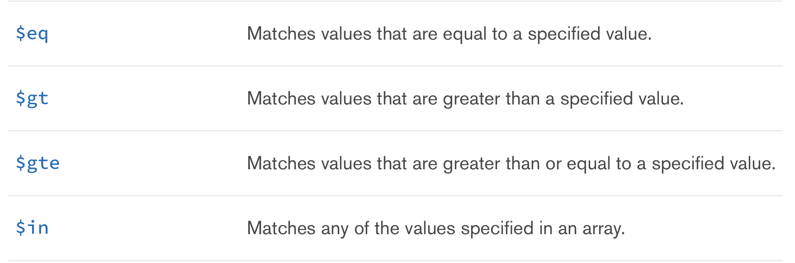
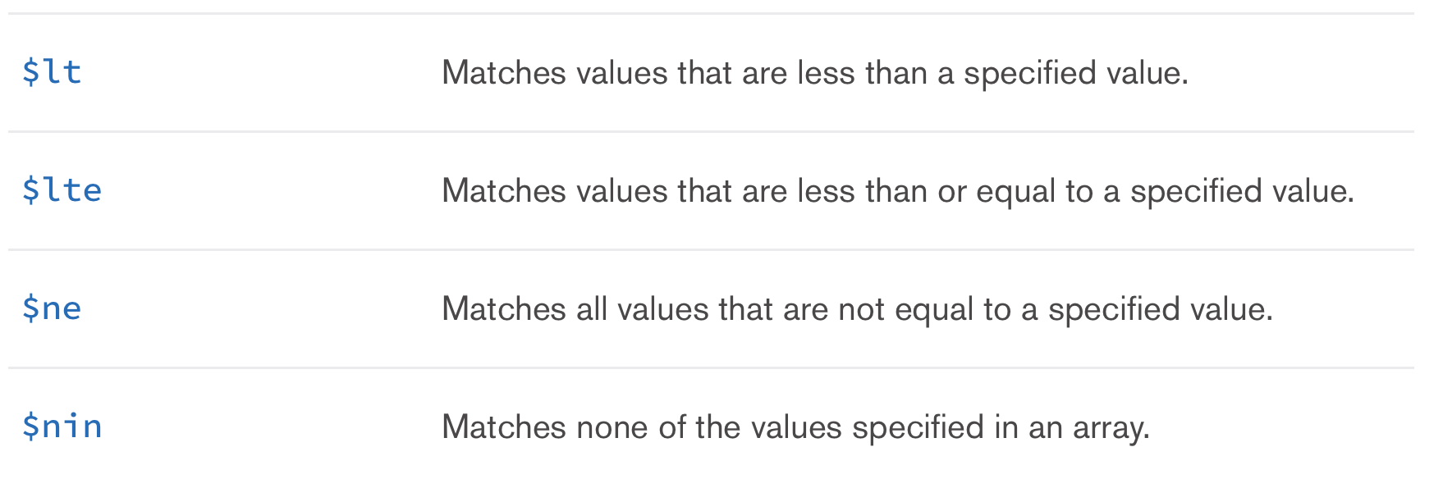
Comparison Query Operations
MongoDB has a number of Comparison Query Operations:

Slide 10
$eq
Specifies equality condition. The $eq operator matches documents where the value of a field equals the specified value.
{ <field>: { $eq: <value> } }

Slide 11
$gt
$gt selects those documents where the value of the field is greater than (i.e. >) the specified value.
db.inventory.find( { qty: { $gt: 20 } } )
db.inventory.update( { "carrier.fee": { $gt: 2 } }, { $set: { price: 9.99 } } )

Slide 12
$gte
$gte selects the documents where the value of the field is greater than or equal to (i.e. >=) a specified value (e.g. value.)
db.inventory.find( { qty: { $gte: 20 } } )
db.inventory.update( { "carrier.fee": { $gte: 2 } }, { $set: { price: 9.99 } } )

Slide 13
$in
The $in operator selects the documents where the value of a field equals any value in the specified array. To specify an $in expression, use the following prototype:
For comparison of different BSON type values, see the specified BSON comparison order.
{ field: { $in: [<value1>, <value2>, ... <valueN> ] } }

Slide 14
$lt
$lt selects the documents where the value of the field is less than (i.e. <) the specified value.
db.inventory.find( { qty: { $lt: 20 } } )
db.inventory.update( { "carrier.fee": { $lt: 2 } }, { $set: { price: 9.99 } } )

Slide 15
$lte
$lte selects the documents where the value of the field is less than or equal to (i.e. <=) the specified value.
db.inventory.find( { qty: { $lte: 20 } } )
db.inventory.update( { "carrier.fee": { $lte: 2 } }, { $set: { price: 9.99 } } )

Slide 16
$ne
$ne selects the documents where the value of the field is not equal to the specified value. This includes documents that do not contain the field.
db.inventory.find( { qty: { $ne: 20 } } )
db.inventory.update( { "carrier.state": { $ne: "NY" } }, { $set: { qty: 20 } } )

Slide 17
$nin
$nin selects the documents where:
the field value is not in the specified array or
the field does not exist.
db.inventory.find( { qty: { $nin: [ 5, 15 ] } } )

Slide 18
Logical Query Operations

Slide 19
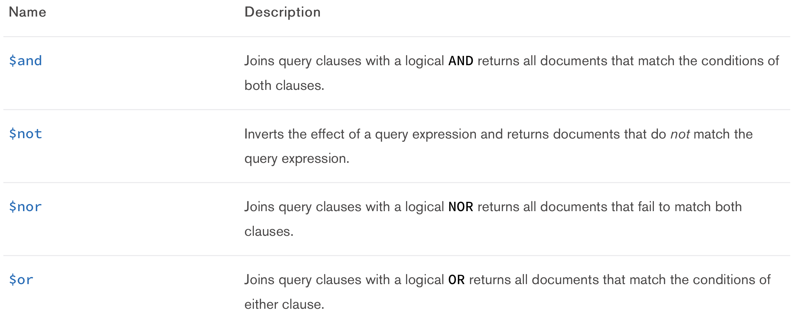
Logical Query Operations
MongoDB has a number of Logical Query Operations:

Slide 20
$and
$and performs a logical AND operation on an array of one or more expressions (e.g. <expression1>,<expression2>, etc.) and selects the documents that satisfy all the expressions in the array.
The $and operator uses short-circuit evaluation. If the first expression (e.g. <expression1>) evaluates to false, MongoDB will not evaluate the remaining expressions.
db.inventory.find( { $and: [ { price: { $ne: 1.99 } }, { price: { $exists: true } } ] } )

Slide 21
$not
$not performs a logical NOT operation on the specified <operator-expression> and selects the documents that do not match the <operator-expression>.
This includes documents that do not contain the field.
db.inventory.find( { price: { $not: { $gt: 1.99 } } } )

Slide 22
$nor
$nor performs a logical NOR operation on an array of one or more query expression and selects the documents that fail all the query expressions in the array.
The $nor has the following syntax:
{ $nor: [ { <expression1> }, { <expression2> }, ... { <expressionN> } ] }

Slide 23
$or
The $or operator performs a logical OR operation on an array of two or more <expressions> and selects the documents that satisfy at least one of the <expressions>.
The $or has the following syntax:
{ $or: [ { <expression1> }, { <expression2> }, ... , { <expressionN> } ] }

Slide 24
Skipping and Limiting the Number of Documents Returned

Slide 25
Limit
When we query a collection, it shows all the documents contained in it. The limit cursor is used for retrieving only numbers of documents that we need. We can use MongoDB limit() method to specify the number of documents we want it to return.
const movieCollection = await movies();
const movieList = await movieCollection.find({}).limit(20).toArray();
return movieList;

Slide 26
Skip
When we use the MongoDB limit() method, it shows from the beginning of the collection to the specified limit. If we want it to start not from the beginning and skipping some documents, we can use the skip() method for this task.
To do this, we need to add the skip() in the cursor and specify the number of documents that we want to skip.
const movieCollection = await movies();
const movieList = await movieCollection.find({}).skip(10).toArray();
return movieList;
We can use limit and skip together:
const movieCollection = await movies();
const movieList = await movieCollection.find({}).skip(10).limit(20).toArray();
return movieList;

Slide 27
Returning Only Certain Fields

Slide 28
{
_id: 1,
title: 'Inception',
rating: 4.5,
reviews: [
{
_id: '9e6b393c-4678-4fa3-a714-5c3bba0331cc',
title: 'Really Good',
comment: 'This movie was so interesting.',
reviewer: 'Phil',
rating: 4.5
},
{
_id: '13fa5b13-6d1f-4807-a033-b2a5cd2c3e22',
title: 'Bad',
comment: 'This movie is trite.',
reviewer: 'Agatha',
rating: 2
},
{
_id: 'ac0fcaf2-8899-4ddb-bec6-eb7f0f283db4',
title: 'Perfect',
comment: 'Leo should win an Oscar for this.',
reviewer: 'Definitely Not Leo',
rating: 4
}
],
cast: ['Leonardo DiCaprio','Ellen Page','Ken Watanabe','Joseph Gordon-Levitt','Marion Cotillard','Tom Hardy'
],
info: {
release: 2015,
director: 'Christopher Nolan'
}
}

Slide 29
Returning Certain Fields
By default, queries in MongoDB return all fields in matching documents. To limit the amount of data that MongoDB sends to applications, you can include a projection document to specify or restrict fields to return.
const movieCollection = await movies();
const movieList = await movieCollection
.find({}, { projection: { _id: 0, title: 1, 'info.director': 1, rating: 1, cast: 1 } }).toArray(); return movieList;
This will ONLY return the fields, title, info.director(a part of a subdocument), rating and the array of cast members.
We can include fields by using the value 1 and exclude fields by using a value of 0

Slide 30
Sorting

Slide 31
Sorting
Specifies the order in which the query returns matching documents. You must apply sort() to the cursor before retrieving any documents from the database.
getAllMoviesSortedByTitleAsc: async () => {
const movieCollection = await movies();
const movieList = await movieCollection.find({}).sort({ title: 1 }).toArray();
return movieList;
},
getAllMoviesSortedByTitleDec: async () => {
const movieCollection = await movies();
const movieList = await movieCollection.find({}).sort({ title: -1 }).toArray();
return movieList;
}

Slide 32
Sorting
Sorted by Title, then release year
const movieCollection = await movies();
const movieList = await movieCollection.find({}).sort({ title: 1, 'info.release': 1 }).toArray();
return movieList;
We can also use limit and skip with sort:
const movieCollection = await movies();
const movieList = await movieCollection
.find({})
.skip(1)
.limit(2)
.sort({ title: 1, 'info.release': 1 })
.toArray();
return movieList;

Slide 33
API: POST, PUT, PATCH, DELETE

Slide 34
POST, PUT, PATCH, DELETE
POST
The POST method is used to submit an entity to the specified resource, often causing a change in state or side effects on the server.
PUT
The PUT method replaces all current representations of the target resource with the request payload.
PATCH
Similar to PUT, but you can replace portions of the resource instead of the whole resource.
DELETE
The DELETE method deletes the specified resource.
Each of these request types can use the following types of data:
Querystring parameters
Request bodies
URL Params
Headers

Slide 35
The Request Body
POST, PUT, PATCH and DELETE requests can all provide data in a request body.
A request body is a series of bytes transmitted below the headers of an HTTP Request.
We will be submitting a request body in two ways:
Text that is in a JSON format (modern format of submitting data)
Text that is in a form data format (traditionally how browsers POST)
The request body will be interpreted by our server using the express.json middleware
Function that is built into Express
https://expressjs.com/en/api.html#express.json

Slide 36
Using Request Body Data
In order to access request body data, we must first apply the express.json middleware.
This will allow us to add text that is formatted as JSON to a request body, and to have our server parse the JSON and place the object in the request.body property.
This will allow us to submit data with our POST, PUT, PATCH and DELETE calls and begin interacting with our server.
https://expressjs.com/en/api.html#express.json

Slide 37
Using Postman
As we use more methods, such as POST, PUT, PATCH and DELETE, it becomes increasingly difficult to test using just your browser, particularly because you cannot directly PUT, PATCH and DELETE from the browser! The browser only knows a GET and POST request.
You can use a REST client such as Postman and PAW to test your API calls.
https://www.getpostman.com/
https://luckymarmot.com/paw
A REST client is a program that will allow you to easily configure and make HTTP Calls to your servers.

Slide 38
Using Postman to Send JSON Data
In order to use Postman, you need:
The URL you wish to submit data to
The request method you wish to use
Body data
You must set the body type to raw
You must also set the type to JSON (application/json)

Slide 39
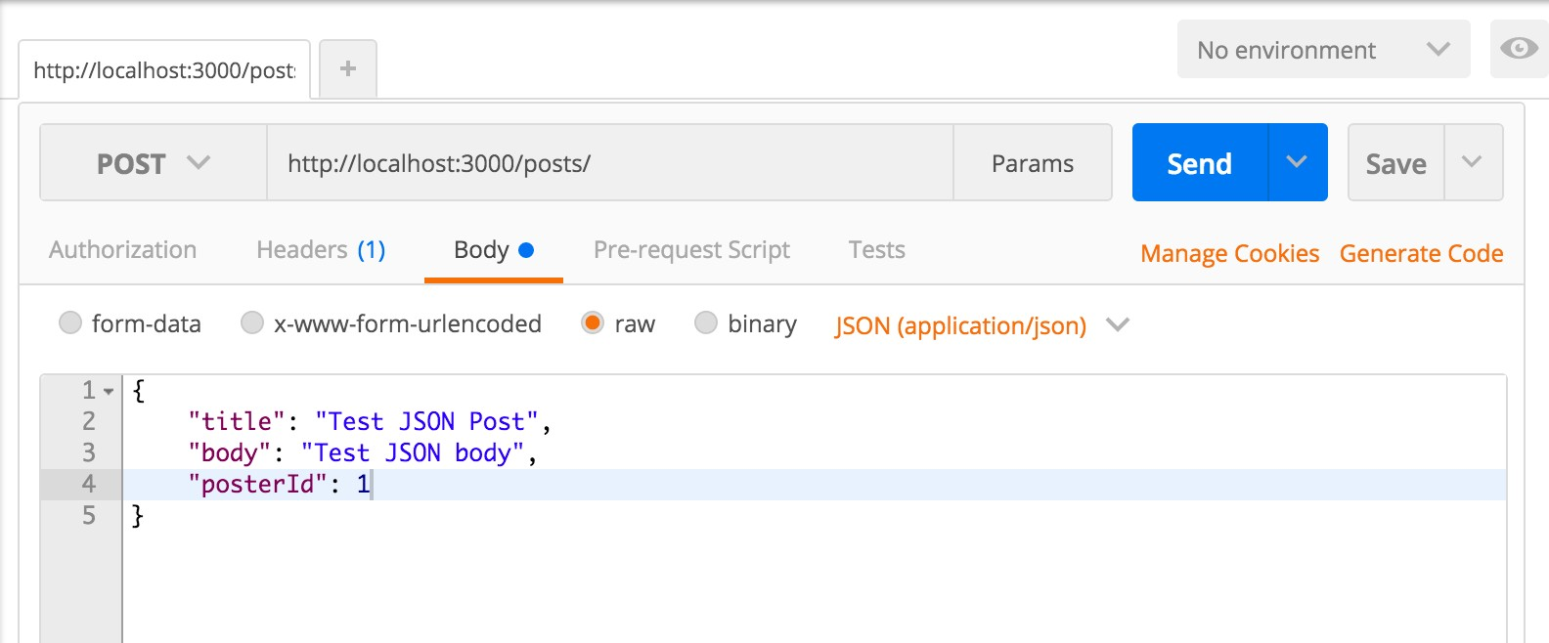
Adding a Blog Post with Postman

Slide 40
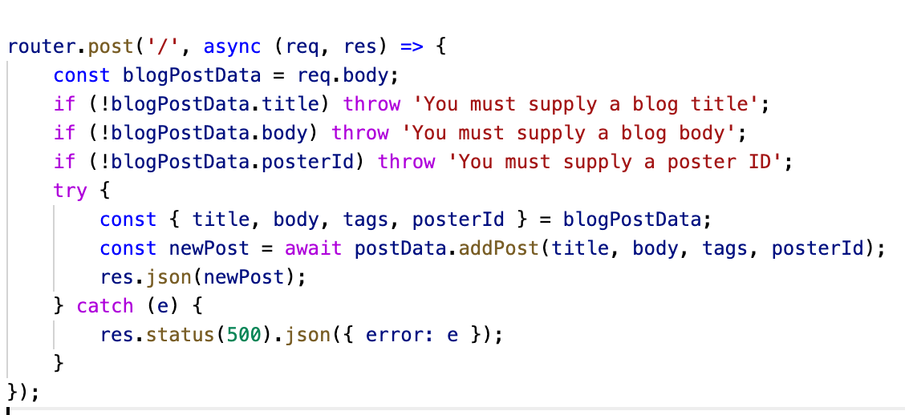
Using the Data That Was Sent in the Request
We can access the data that was sent in the request’s body inside the route, we then call our DB function addPost() to add the post to the DB :

Slide 41
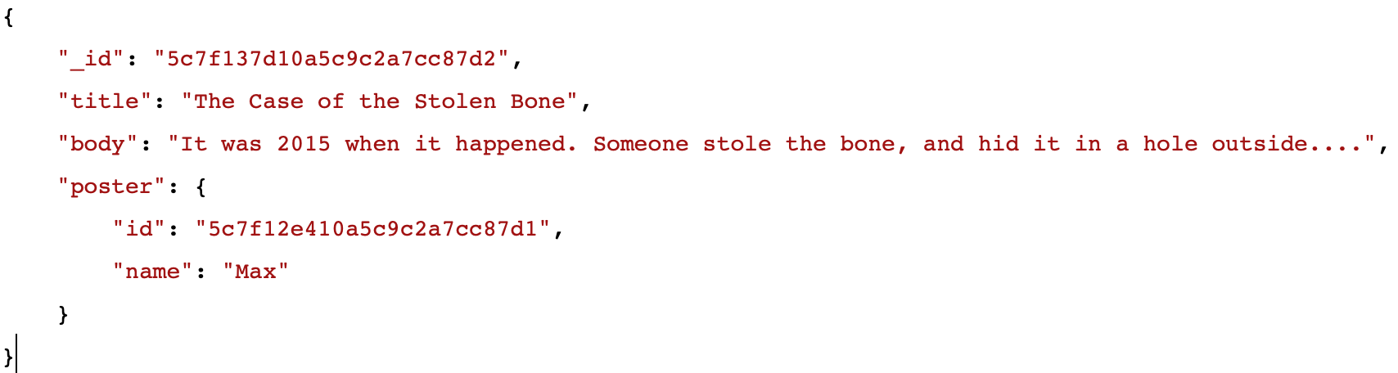
Updating Data - PUT
There are two ways to update data; PUT and PATCH the difference between the two is how the data is updated. With a PUT request, all the fields of the object need to be supplied. For example. Say we have the following object in our DB that we wanted to update:

Slide 42
Updating Data - PATCH
With a PUT request, all the fields need to be supplied in the request body, if they are not supplied, you would need to throw an error. You can think of a PUT request as a full replacement of the object, so all the fields in the object need to be supplied in the request body. With a PATCH request, you only have to supply one or more of the fields in the request body. As long as there is at least one field present, then you can proceed with updating just that field in the DB. So just as it sounds, PATCH allows you to “patch” the data, only replacing the data that has changed, as opposed the PUT request where the new data replaces the old data completely.

Slide 43
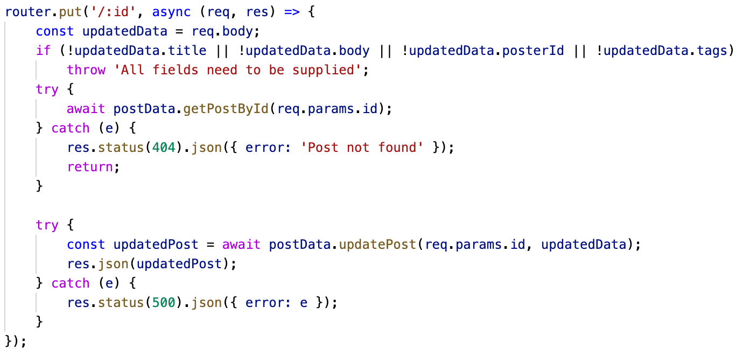
Updating Data – PUT Route

Slide 44
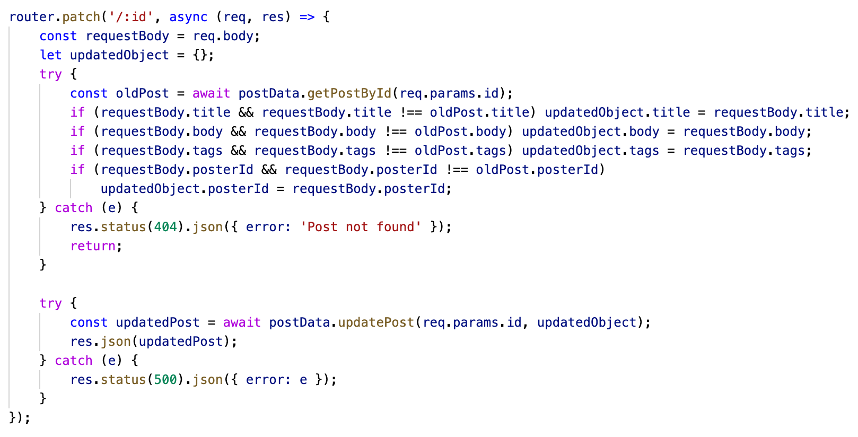
Updating Data – PATCH Route

Slide 45
Deleting Data
Informing your server that you want to delete an entity is extremely easy. Much like PUT, you would send a DELETE call to a URL that contains the identifier.
That means to delete a blog post with an id of 3 you would DELETE to http://localhost:3000/blog/3
router.delete('/:id', async (req, res) => {
try {
await postData.getPostById(req.params.id);
} catch (e) {
res.status(404).json({ error: 'Post not found' });
return;
}
try {
await postData.removePost(req.params.id);
res.sendStatus(200);
} catch (e) {
res.status(500).json({ error: e });
}
});

Slide 46
Server-Side Error Checking

Slide 47
What is Server-Side Validation?
Users will submit errors; it’s a fact of life that as a web developer, you will encounter situations where an error is submitted.
There are many types of errors that can occur:
The user tries to request a resource that does not exist
The user inputs data that does not make sense (bad arguments/parameters/ querystring data)
The user is not authenticated
The input the user provides does not make sense
The user is attempting to access resources they do not have access to

Slide 48
Server-Side Error Checking
Whenever input comes from a user, you must check that this input is:
Actually there!
Actually the type you want!
For example, you may have to change from strings to numbers
Actually valid!
When you write a calculator that you wouldn’t let someone divide by 0
There are two places you will need to perform error checking:
Inside of your routes; this will easily catch user submitted errors
Inside of your data modules; this will allow you to ensure that you don’t create bad data.

Slide 49
Error Handling in an API
While we build out these APIs, error handling is extremely easy! When you encounter an issue in your API routes, you will:
Determine what type of error it is (i.e., the user is requesting an object that does not exist) and respond with the proper status code.
In addition to the failed status code, also send back a JSON object that describes what happened. It can be as simple as having a property called errorMessage with a string describing the error, or an array of all the errors!

Slide 50
Questions?

